Slide 1
LECTURE 7
Advanced Blueprint Concepts

Slide 2
10th May 2021- Tue,18:00
Deadline for submitting Assignment #2
After the deadline, every day will make you lose 10% score!

Slide 3
FLOW CONTROL

Slide 4
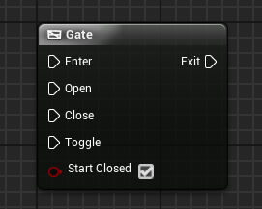
GATE NODE
The Gate node is a flow control node that can be open or closed. If it is open, it allows the execution of the actions related to the Exit pin.

Slide 5
GATE NODE:
INPUT AND OUTPUT
Input
Enter: Execution pin that receives the current flow of execution.
Open: Execution pin that changes the state of the gate to “open”.
Close: Execution pin that changes the state of the gate to “closed”.
Toggle: Execution pin that toggles the current state of the gate.
Start Closed: Boolean variable that determines if the Gate node should start running in the “closed” state.
Output
Exit: Execution pin that will execute if the gate is open.

Slide 6
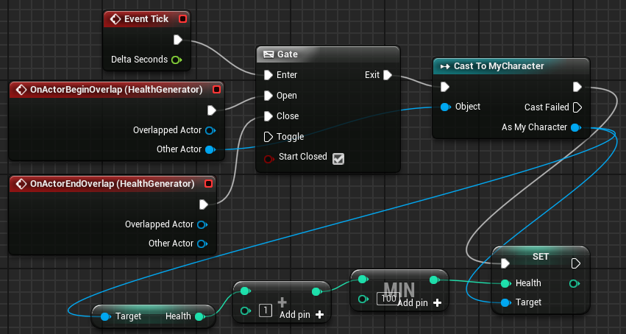
GATE NODE:
EXAMPLE
In the example to the right, there is an Actor called “HealthGenerator”. When the player is colliding with this Actor, their health will be restored slowly with every Tick event.
If the player stops colliding with HealthGenerator, the gate will be closed and the actions that restore health will no longer be performed.
The Min action is used so that the value of the Health variable is never greater than “100”.

Slide 7
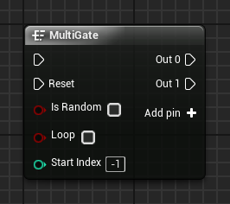
MULTIGATE NODE
A MultiGate node can have multiple output pins. At each execution of the MultiGate, only one of the output pins is executed. The order in which the output pins are executed may be sequential or random.
When all the output pins are executed and if the Loop option is not selected, the MultiGate node will stop executing the output pins. In order for the Multigate to run the output pins again, the Reset pin must be triggered.
Output pins can be added using the Add pin + option. To remove a pin, right-click the pin and choose “Remove execution pin”.

Slide 8
MULTIGATE NODE:
INPUT
Reset: Execution pin used to reset the MultiGate node and allow new executions of the output pins.
Is Random: Boolean variable. If the value is “true”, the order of execution of the output pins is random.
Loop: Boolean variable. If the value is “true”, the MultiGate continues to execute the output pins after the last output pin is executed.
Start Index: Takes in an integer value indicating the first output pin to be executed.

Slide 9
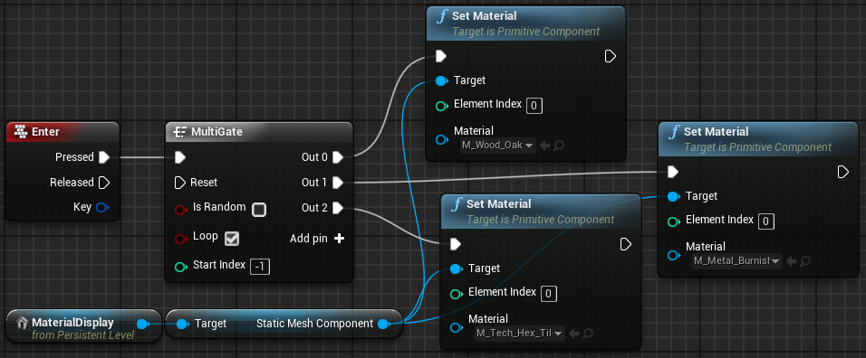
MULTIGATE NODE:
EXAMPLE
In the example on the right, there is an object in the Level called “MaterialDisplay” whose function is to display various Materials for the user.
When the Enter key is pressed, a MultiGate node is used to define a different Material at each execution.
Because the Loop parameter is checked, after the last output pin is executed, the MultiGate will continue executing the output pins, beginning with the first output pin.

Slide 10
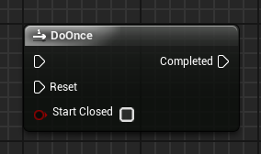
DO ONCE NODE
The DoOnce node performs the actions attached to the output pin only once.
After its first run, if the DoOnce node is called again, its output pin will not run.
In order for the DoOnce node to be able to execute the output pin again, the Reset pin needs to be triggered.
Input
Reset: Execution pin used to allow the DoOnce node to run the output pin.
Start Closed: Boolean variable. If the value is “true”, the DoOnce node needs to be reset to allow the first run.

Slide 11
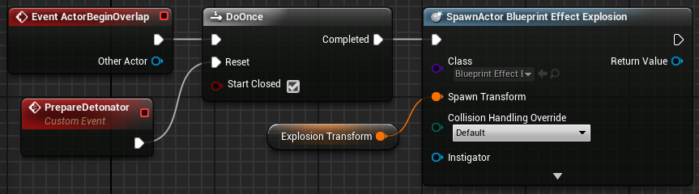
DO ONCE NODE:
EXAMPLE
In the example on the right, there is a detonator that generates an explosion when the player collides with it. This detonator utilizes the DoOnce action. The Start Closed property is checked, indicating that the detonator starts disarmed.
The PrepareDetonator event needs to be executed to trigger the Reset pin of the DoOnce action.
After the Reset pin is triggered, if there is a collision with the detonator the explosion will be created. To allow a new explosion, the PrepareDetonator event needs to be executed again.

Slide 12
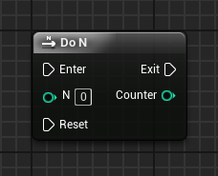
DO N NODE
The Do N node is similar to the DoOnce node, but instead of executing only once, the actions connected to the output pin can execute multiple times.
After the set number of executions have completed, the actions of the output pin will only be executed again if the Reset pin is triggered.
Input
N: Sets the number of times the output pin actions can be executed.
Reset: Execution pin used to reset the Do N count and allow new executions of the output pin.
Output
Counter: Outputs an integer value indicating the current execution number.

Slide 13
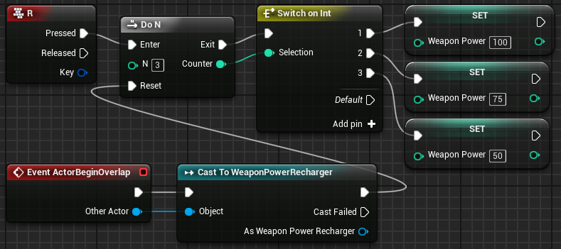
DO N NODE:
EXAMPLE
In the example to the right, a player has a special weapon. When the weapon is fully charged, its power is at 100% capacity. The player can press the “R” key to recharge this weapon. The weapon can be recharged three times.
The first recharge leaves the weapon fully charged; the second recharge leaves it at 75% capacity; and the third recharge recovers only half of the weapon’s capacity. To recharge the weapon again, the player needs to collect an item of type “WeaponPowerRecharger”.

Slide 14
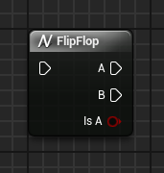
FLIP FLOP NODE
The FlipFlop node has two output pins identified as “A” and “B”. When the FlipFlop is executed, only one of the output pins is executed. On the next run, only the other pin will be executed.
Output
A: Execution pin that will execute if the value of the Is A pin is “true”.
B: Execution pin that will execute if the value of the Is A pin is “false”.
Is A: Boolean variable. If the value is “true”, pin A is running. If “false”, pin B is running.

Slide 15
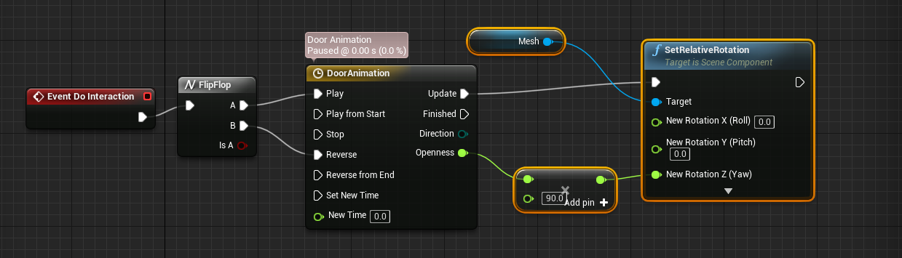
FLIP FLOP NODE
The FlipFlop node has two output pins identified as “A” and “B”. When the FlipFlop is executed, only one of the output pins is executed. On the next run, only the other pin will be executed.
Output
A: Execution pin that will execute if the value of the Is A pin is “true”.
B: Execution pin that will execute if the value of the Is A pin is “false”.
Is A: Boolean variable. If the value is “true”, pin A is running. If “false”, pin B is running.

Slide 16
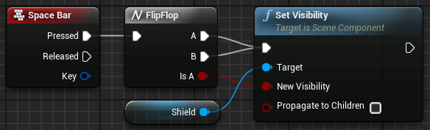
FLIP FLOP NODE:
EXAMPLE
In the example on the right, the FlipFlop node is being used to show or hide a shield when the space bar is pressed.
The value of the Is A output pin is being used to determine the visibility of the shield.

Slide 17
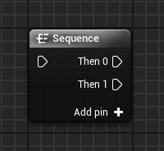
SEQUENCE NODE
A Sequence node can be used to help organize other Blueprint actions. When triggered, it executes all the nodes connected to the output pins in sequential order—that is, it executes all the actions of pin Then 0, then all the actions of pin Then 1, and so on.
Output pins can be added using the Add pin + option. To remove a pin, right-click on the pin and choose the Remove execution pin option.

Slide 18
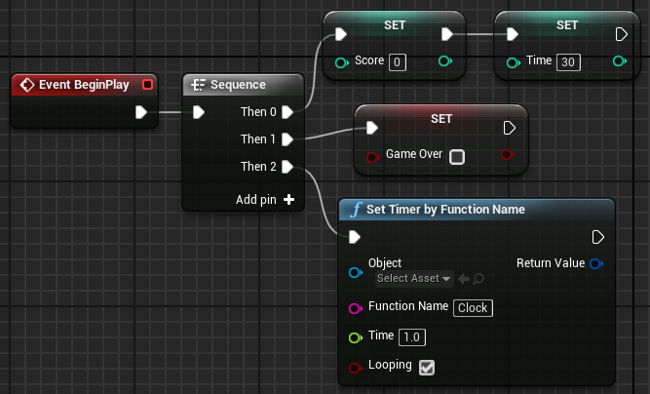
SEQUENCE NODE:
EXAMPLE
In the example on the right, the Sequence node is used to organize the actions that will be executed after the BeginPlay event.
Instead of one execution line being used for all actions, the Sequence node is used to group the actions by similarity.

Slide 19
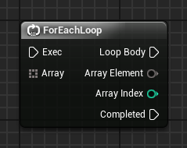
FOR EACH LOOP NODE
The ForEachLoop node takes in an array as an input parameter and performs the set of actions that are associated with the Loop Body output pin for each element of the array that can be obtained from the Array Element output pin. After that, the execution flow is directed to the Completed output pin.
Input
Array: Takes in an array containing the elements that will be used in the loop.
Output
Array Element: Outputs a reference to the current array element.
Array Index: Outputs the index of the current array element.

Slide 20
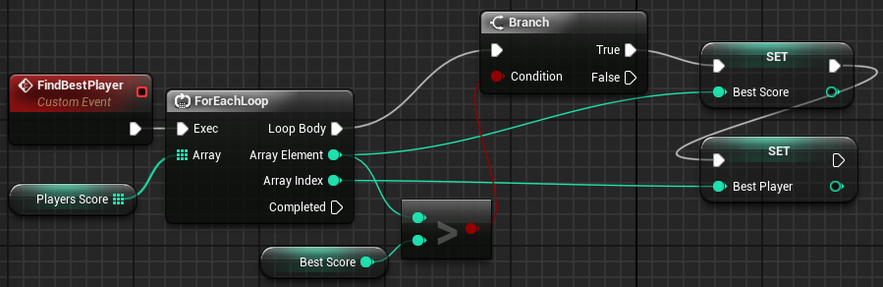
FOR EACH LOOP NODE:
EXAMPLE
In the example on the right, a ForEachLoop node is used to iterate through an array that contains the scores of the players.
For each value, a test is done to check whether it represents the highest score. If “true”, the value is stored in the Best Score variable and the player’s index is stored in the Best Player variable.

Slide 21
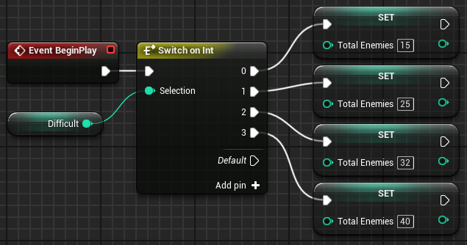
SWITCH ON INT NODE
The Switch on Int node determines the flow of execution according to the integer input value. Output pins are added using the Add pin + option.
Input
Selection: Takes in an integer value that determines which output pin will execute. If the value is not found, the Default pin will execute.
Example
In the example on the right, the difficulty of a game is stored in an integer variable named “Difficult” that can have values ranging from “0” to “3”. The total number of enemies is set according to the difficulty.

Slide 22
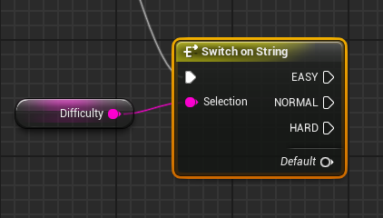
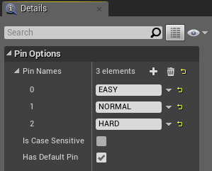
SWITCH ON STRING NODE
The Switch on String node determines the flow of execution according to a string input value. The input string is compared to each of the pin names, and if it matches, the pin will execute.
The output values ​​must be added in the Details panel for the Switch on String node under “Pin Options > Pin Names”, as shown in the bottom image on the right.
Input
Selection: Takes in a string value that determines the output.

Slide 23
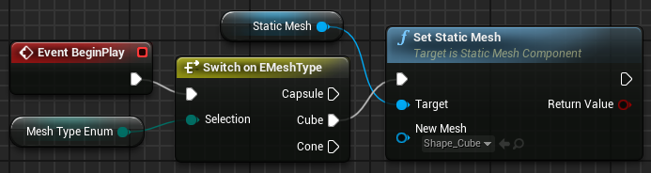
SWITCH ON ENUM NODE
The Switch on Enum node determines the flow of execution according to the enumeration input value. For each enumeration, there is a switch node equivalent.
Example
In the example on the right, the Static Mesh is chosen based on the value of the enumeration variable.

Slide 24
DEBUGGING
“How to take control while your blueprints are being executed runtime.”

Slide 25
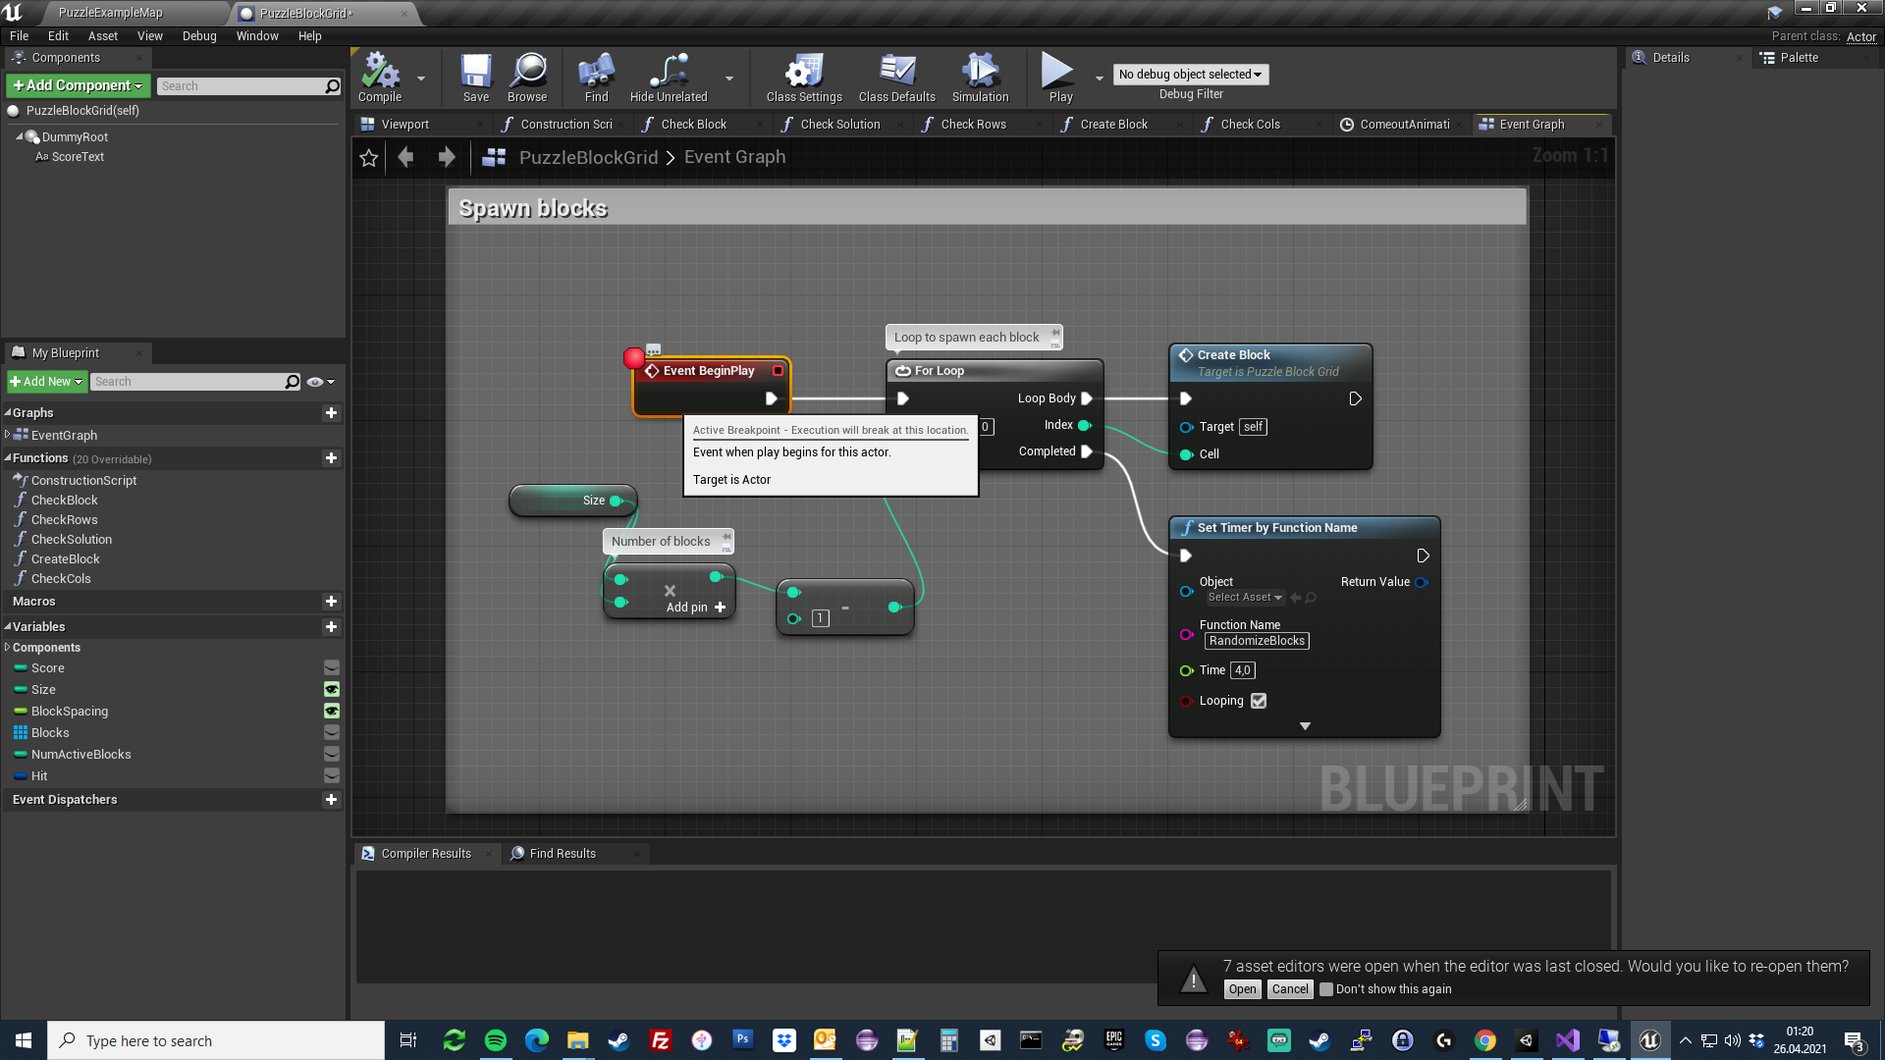
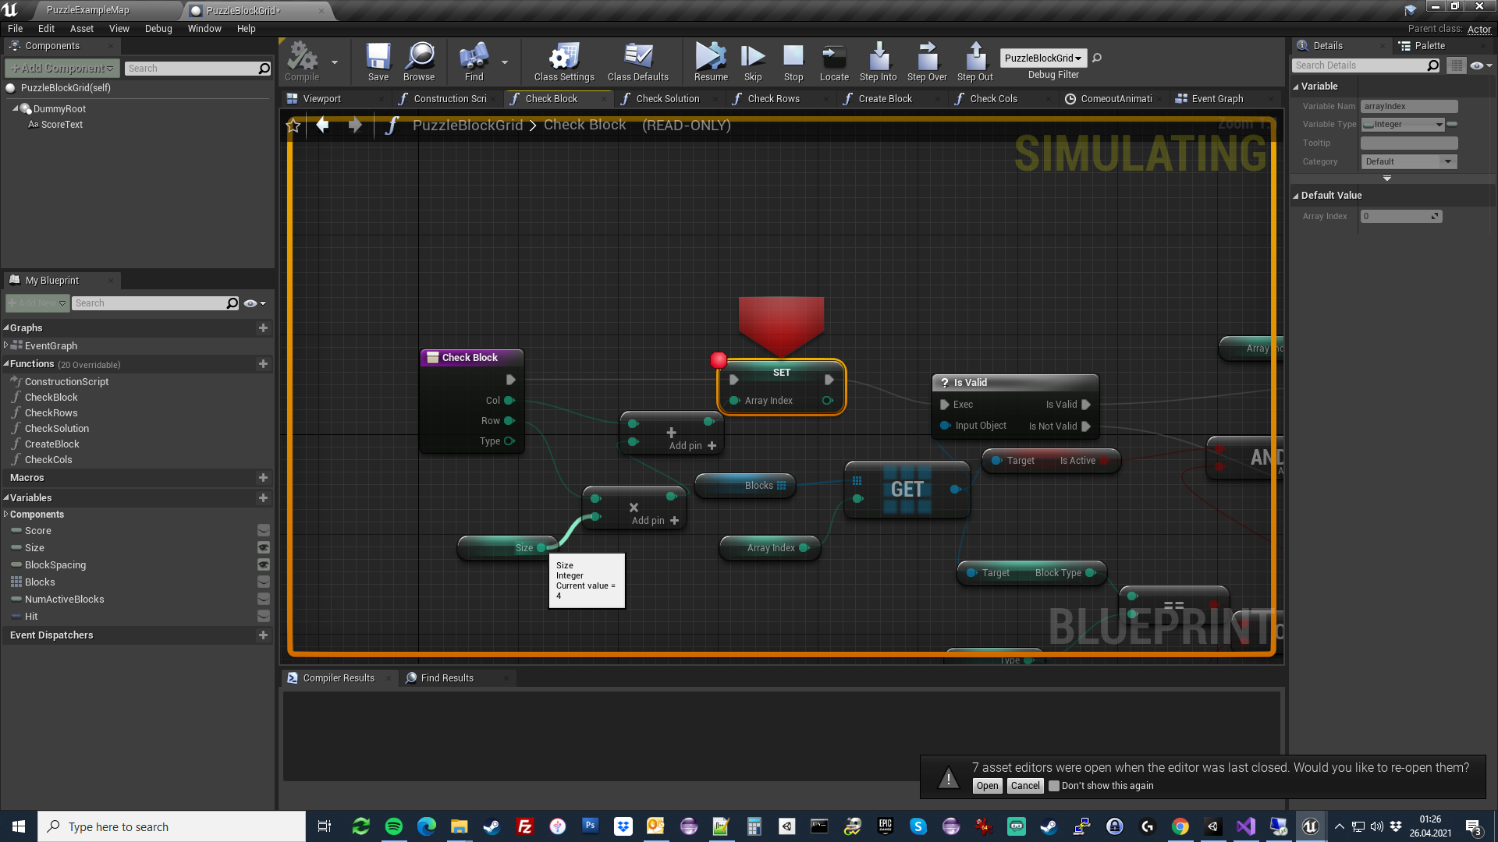
BREAKPOINTS
Press F9 key to toggle a breakpoint over any node in your blueprints.
This way the game execution will immediately stop, if the execution order comes to the node. In other words: your whole game will pause await you to do the next move. Also note that you CAN’T EDIT your blueprints. (Everything becomes read-only.) At this point you can:
1- ESC/Stop: Terminate the game immediately.
2- F10: Step over to the next node.
3- F11: Step into the node. This will enter into any event/function/macro, thus providing you with more details on how you blueprints are being executed.
4- F9: Toggle another node or untoggle the breakpoint so the game won’t pause again.
5- Press “Resume” button and the game continues to run.
6- Hover over data pins to see their current values (VERY USEFUL!!!)

Slide 26
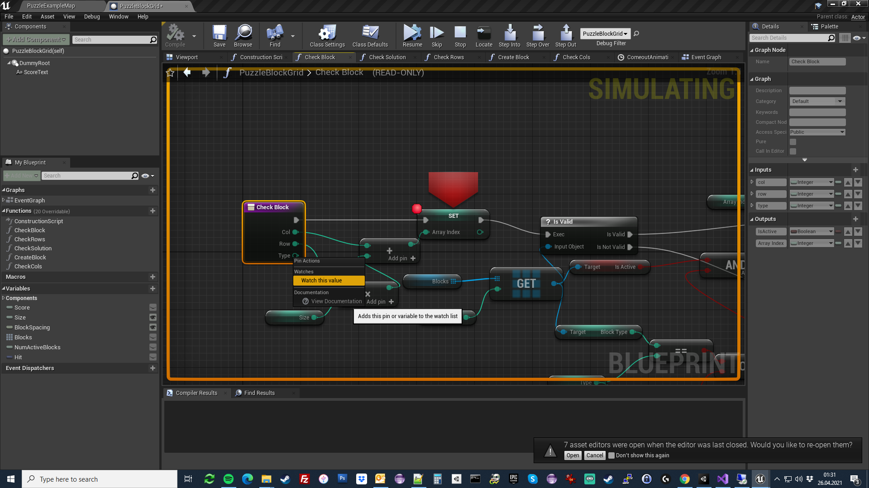
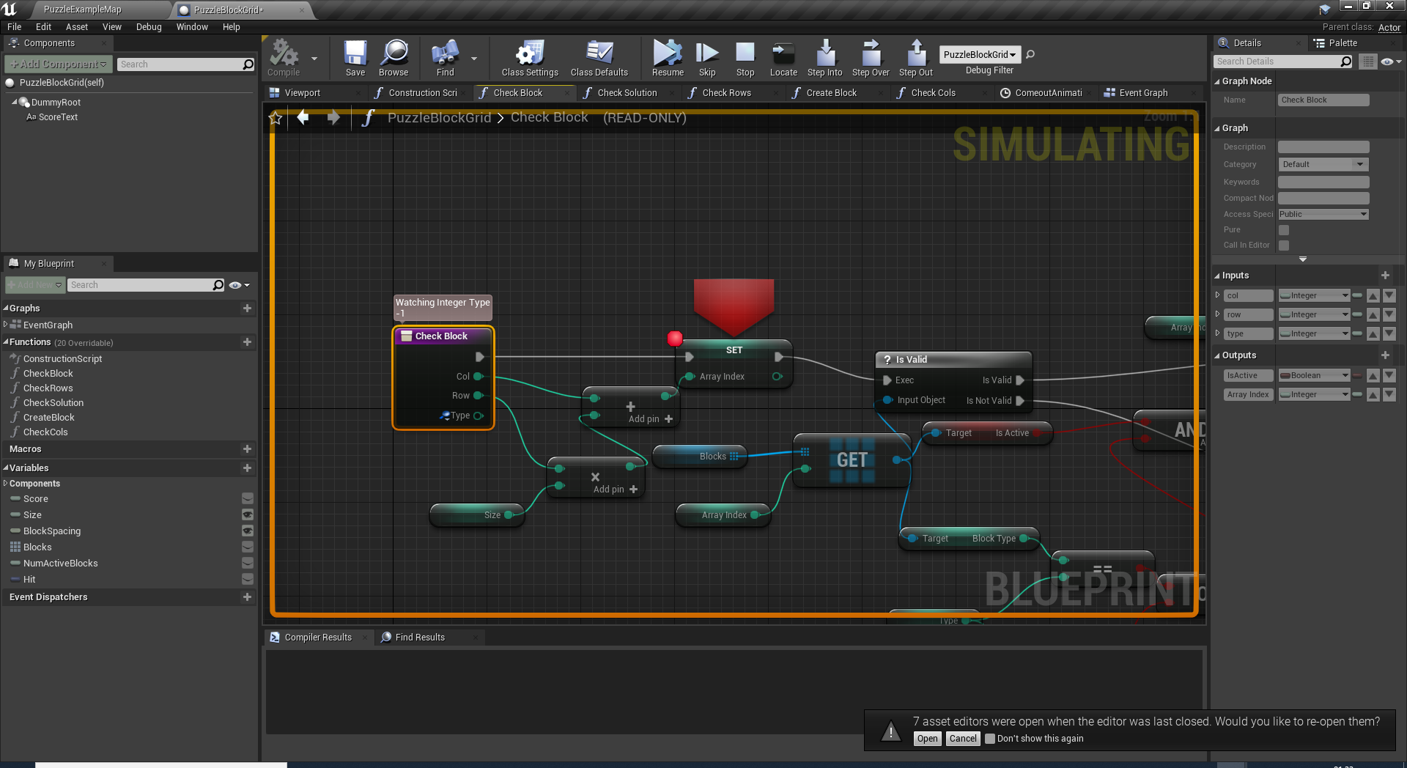
BREAKPOINT TIPS
If some expected behaviour not happening, toggle a breakpoint just before the location it happens.
If your variables are not taking necessary values, also toggle breakpoints to common executing routes to observe their values. You can make the data pin values visible by right-clicking the pin and then selecting “watch this value” option.

Slide 27
STRINGS / TEXT

Slide 28
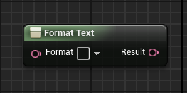
FORMAT TEXT NODE
The Format Text node builds a text based on parameters that can be specified in the Format parameter.
Input
Format: Takes in the text that will be part of the final result. To set parameters, simply put a name between the delimiters { } for each parameter.
Parameters defined in “Format”: For each pair of curly braces, a new input parameter is generated with the name that is between the braces.
Output
Result: Outputs the final text built with the values of the Format parameter and the other parameters.

Slide 29
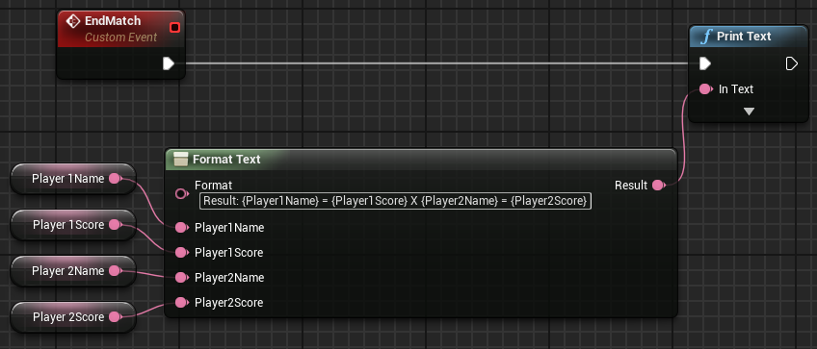
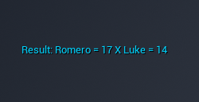
FORMAT TEXT NODE:
EXAMPLE
In the example on the right, a text will appear at the end of a match that displays the result. This text contains the values of four variables related to the names and scores of two players.
The text used in the Format parameter is as follows:
Result: {Player1Name} = {Player1Score} X {Player2Name} = {Player2Score}
After placing the value of the Format parameter, the Blueprint Editor generates the other input parameters.
The top image shows the Format Text node.
The bottom image shows an example of the generated text.

Slide 30
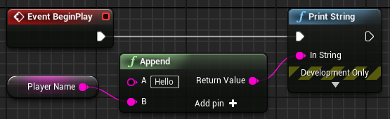
APPEND NODE
The Append node concatenates strings to create a new string. More string pins can be added using the Add pin + option.
In the example on the right, a custom welcome message is created using the player name, which is in a variable.

Slide 31
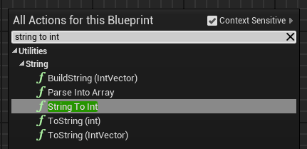
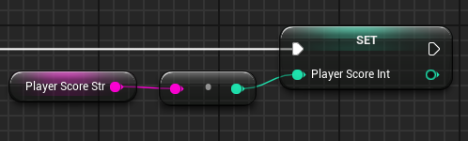
STRING TO INT NODE
Sometimes the same information contained in a string variable for the purpose of display is needed for use as an integer or float value for calculations.
To convert a string value to an integer value, you can use a function node called “String To Int”.
This conversion can also be done by just connecting the pin of a Get String node with the pin of an integer input. The Editor will automatically create the String To Int node, as seen in the bottom example on the right.

Slide 32
Homework #2
Simple Puzzle Game

Slide 33
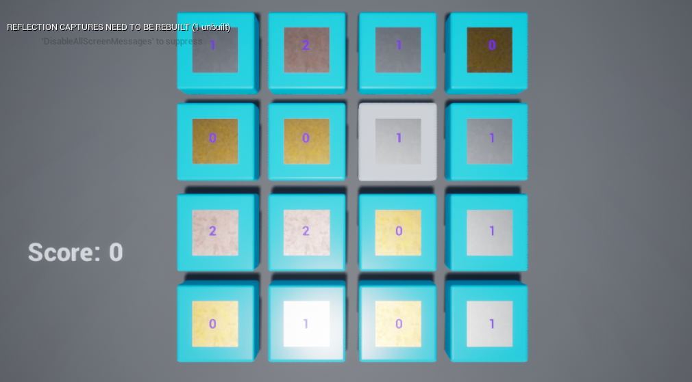
GAME CLASSES
The game created in this lecture is based on the Puzzle Game template. The game uses four main Blueprint classes:
PuzzlePlayerCharacter: A Pawn subclass that represents the player and is part of the Third Person template. This class is assigned to the Default Pawn Class parameter of the Game Mode. Under CharacterMovement component GravityScale is 0.0. So the player never falls on the ground.
PuzzleBlockGrid: An Actor class that is responsible to generate and destroy all puzzle blocks.
PuzzleBlock: Respresents one puzzle block with a different material / shape on it.
PuzzlePlayerController:Used to enable mouse click and hover events.

Slide 34
GAME MECHANICS
Player can click on the puzzle blocks and highlight them.
Each block has a different material representation: Gold, Copper and Nickel.
Highlighting 3 of the same type vertically or horizontally will destroy the selected blocks.
Player can highlight up to 3 blocks. If there is no match then selection is reset.
Every time blocks are destroyed, new random ones are spawned.
Every 2 seconds the whole blocks will randomly change materials.
During breaking animations randomly changing will pause and restart after the animation ends.

Slide 35
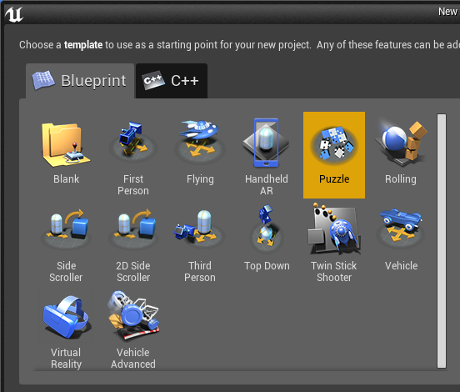
CREATING THE PROJECT
Create a new project using the Puzzle template with starter content.
In the Content Browser, browse to PuzzleBP/Blueprints folder.

Slide 36
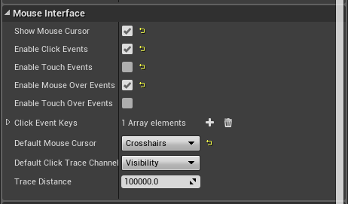
PUZZLEPLAYERCONTROLLER
Notice and make sure that
Show Mouse Cursor
Enable Click Events
Enable Mouse Over Events
are all checked.

Slide 37
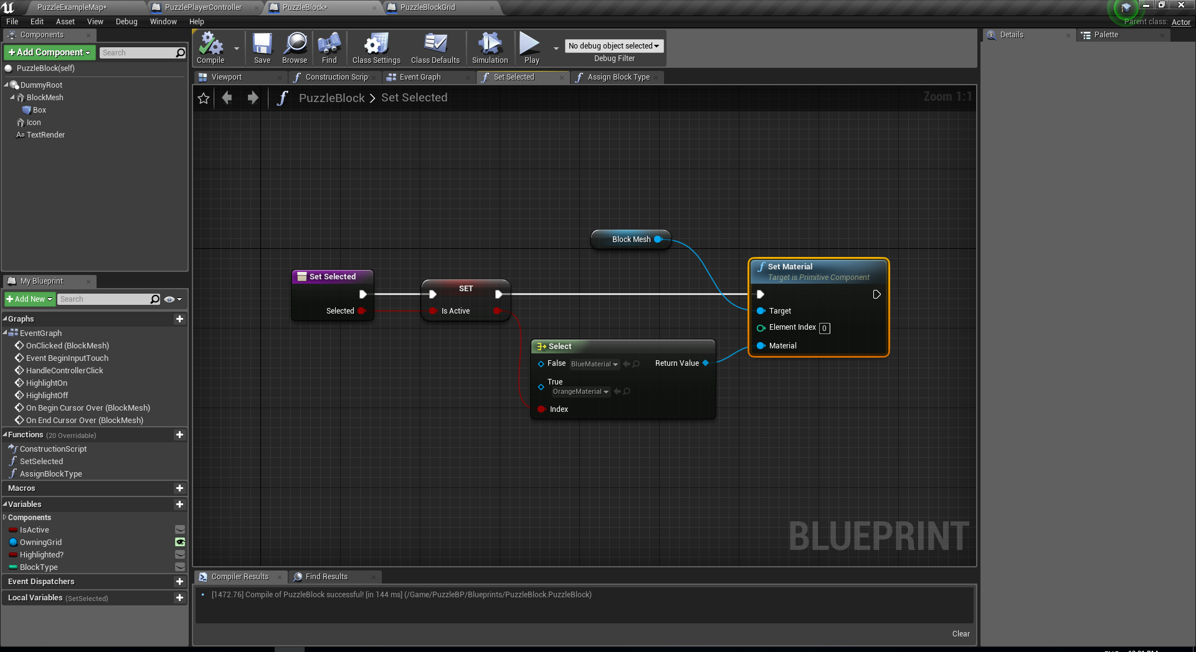
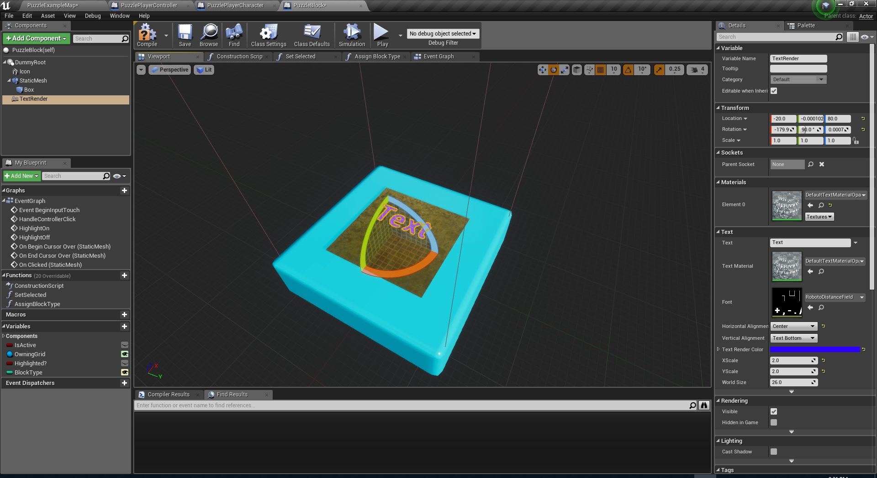
PUZZLEBLOCK
Add SetSelected function.
Add BlockType Integer variable.
Go to viewport and add 2 components under DummyRoot:
Icon (StaticMesh)
StaticMesh => Shape_Plane
Location => 0,0,60
Scale => 1.5,1.5,1.5
Collision Presets => No Collision
Text (TextRender)
Location=>-20,0,80
Rotation=> -180,90,0
Horizontal Alignment => Center

Slide 38
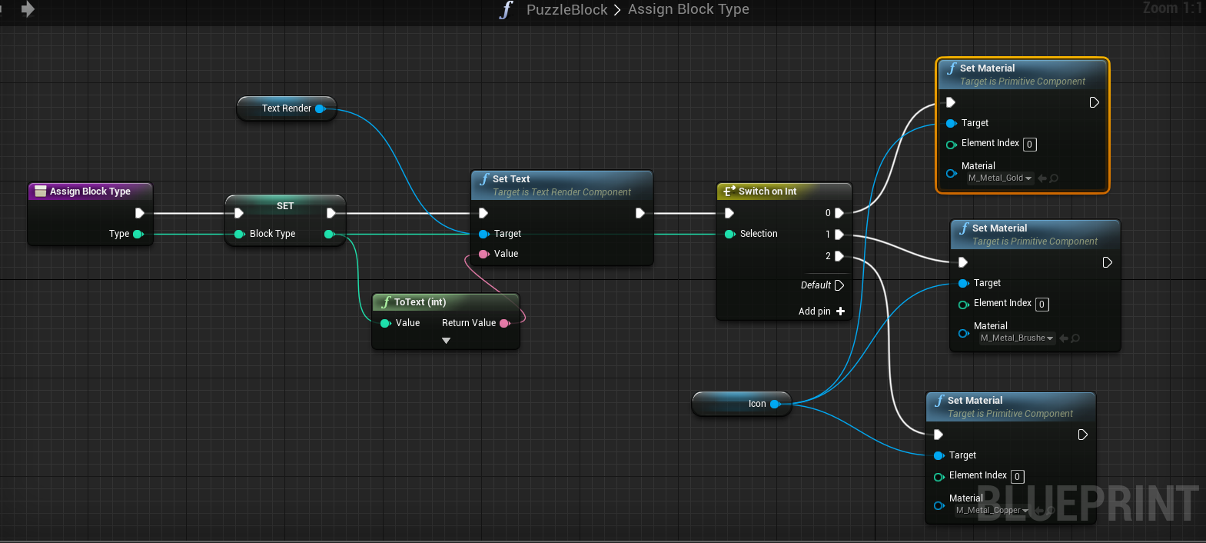
PUZZLEBLOCK
Add AssignBlockType function.

Slide 39
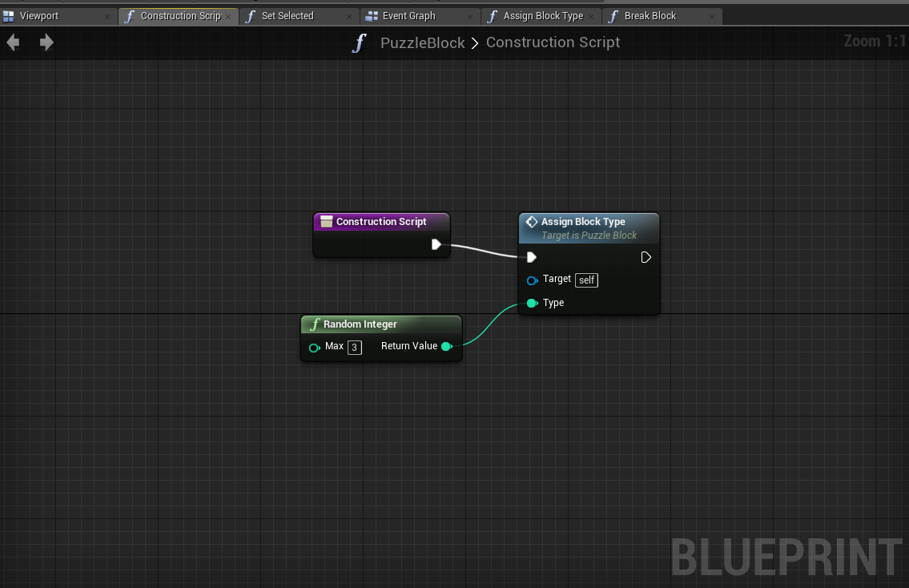
PUZZLEBLOCK
Implement the construction script.

Slide 40
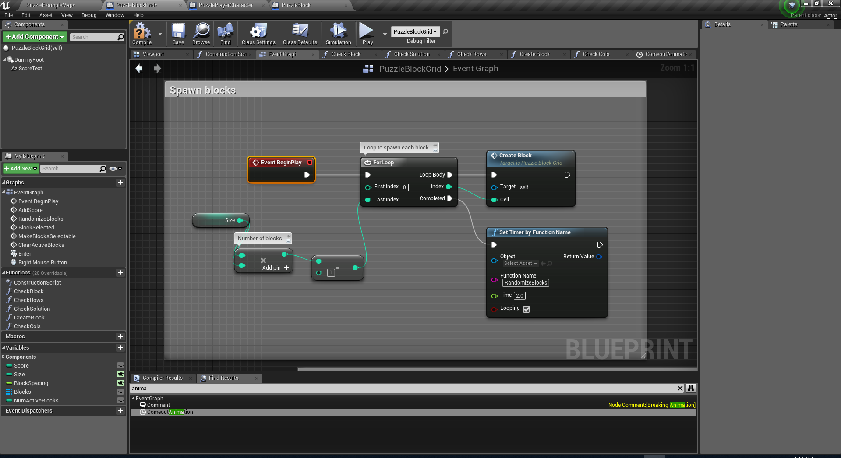
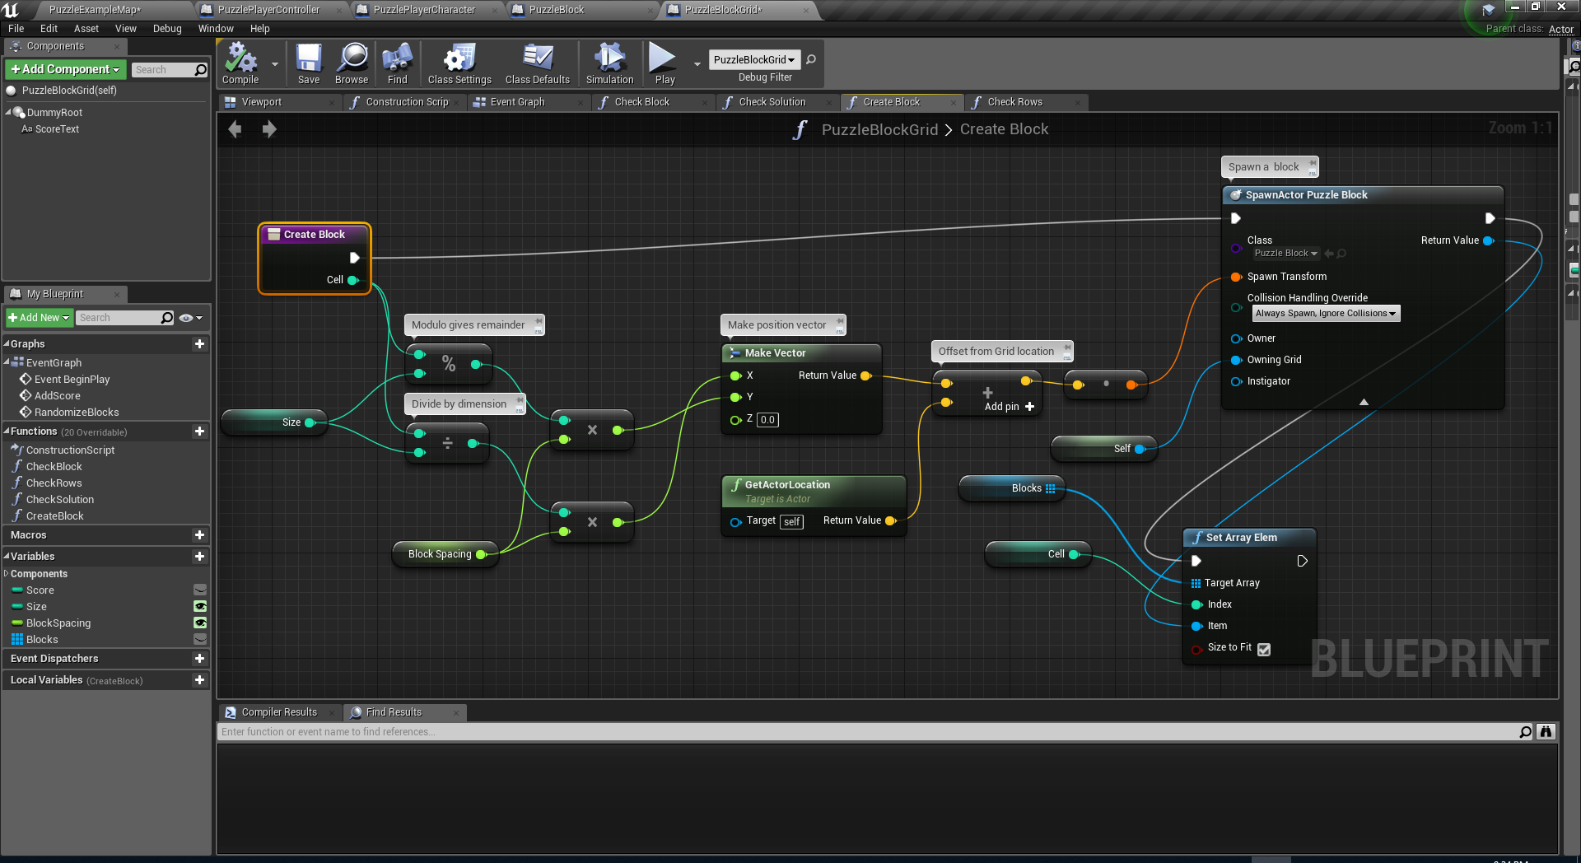
PUZZLEBLOCKGRID
Add Blocks Array variable of type PuzzleBlock.
Add CreateBlock function.
Change BeginPlay as shown.
Set the default value for the Size integer variable to 4. This will make our game to be played on a 4x4 grid.
New Node: Set Array Elem
Set the location of the CameraActor in the scene so that the camera will center on the grid area.
Location => (X=300,Y=130,Z=1200)

Slide 41
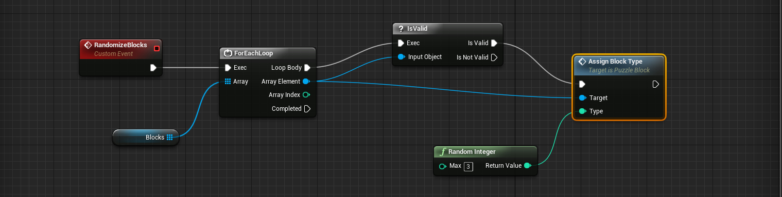
PUZZLEBLOCKGRID
Add RandomizeBlocks event.

Slide 42
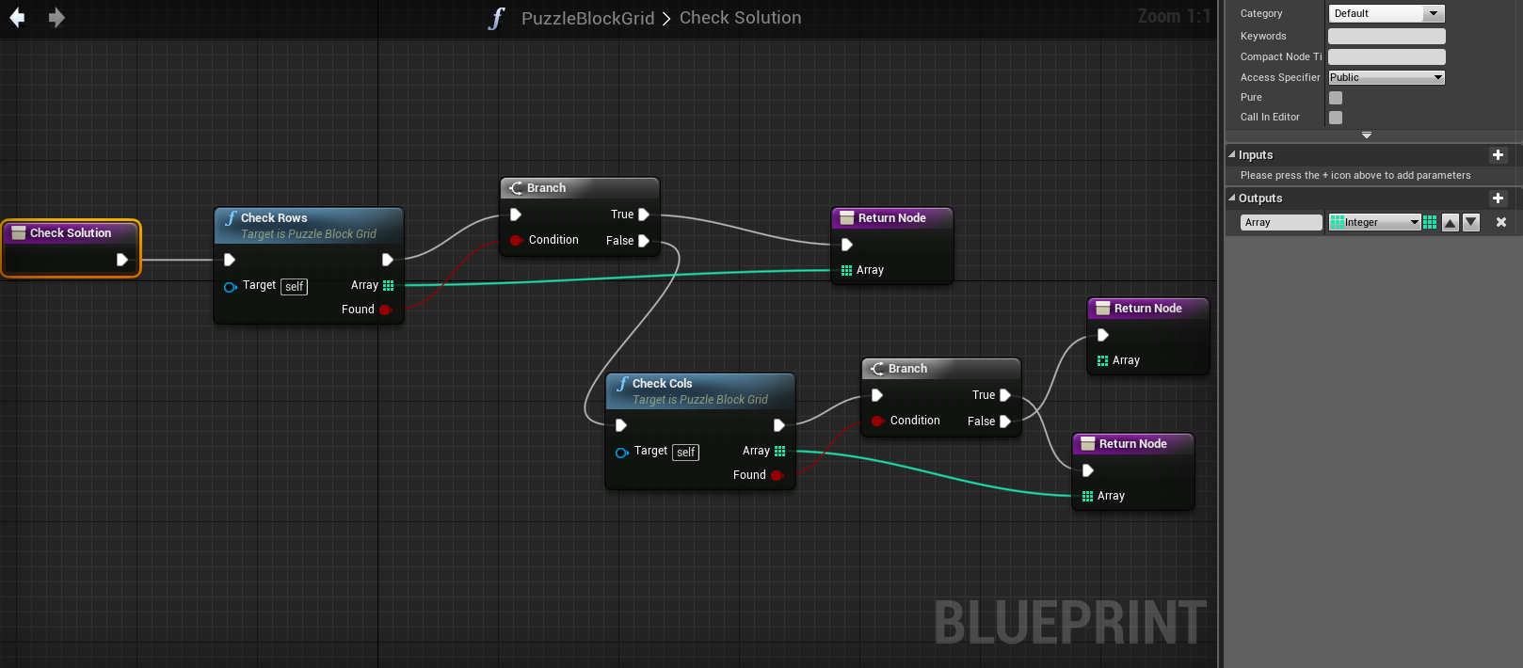
PUZZLEBLOCKGRID
Add CheckSolution function.
This function return an integer array for the blocks to be broken.
This function will check possible solutions whenever a player clicks on the blocks.
For start make the CheckRows and CheckCols functions and leave them empty.

Slide 43
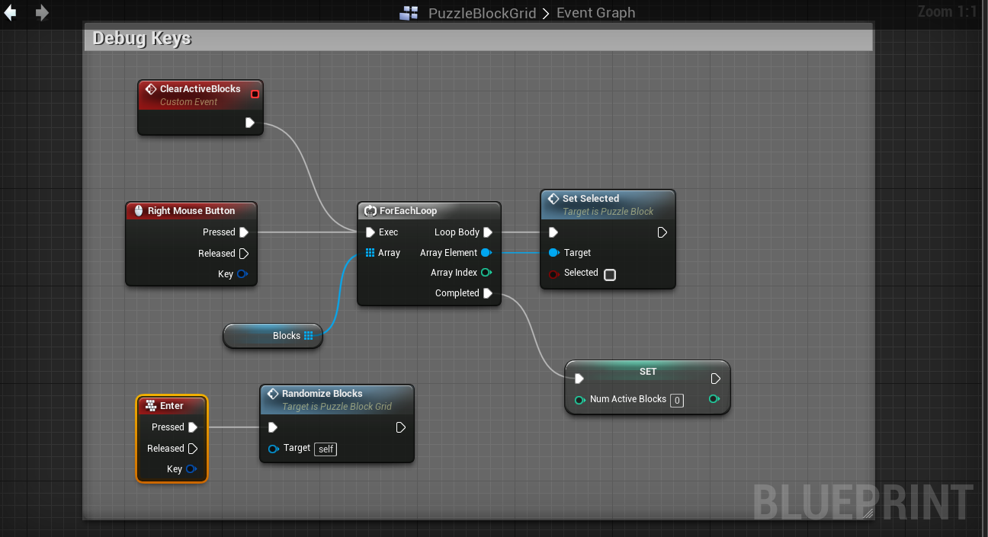
PUZZLEBLOCKGRID
Add a debug Enter key event for regenerating puzzle block types.
Right Clicking will also clear the selection on the blocks.
Add an Integer variable named NumActiveBlocks to hold the number of selected blocks.
Also add custom event ClearActiveBlocks and connect it to Right Mouse Click as well.

Slide 44
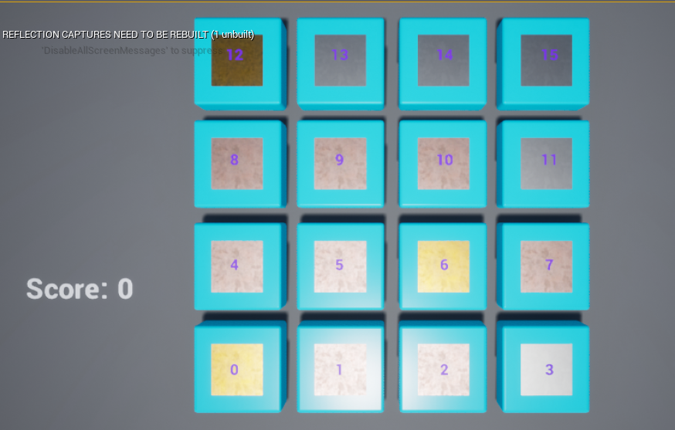
ARRAY SLOTS
This is how the BlockGrids are stored in Blocks Array of PuzzleBlockGrid.
Rows
(0-3)
Col | Row | Array Index
0 | 0 | 0
1 | 0 | 1
2 | 0 | 2
3 | 0 | 3
0 | 1 | 4
1 | 1 | 5
2 | 1 | 6
3 | 1 | 7
2 | 3 | 14
1 | 2 | 9
Cols (0-3)

Slide 45
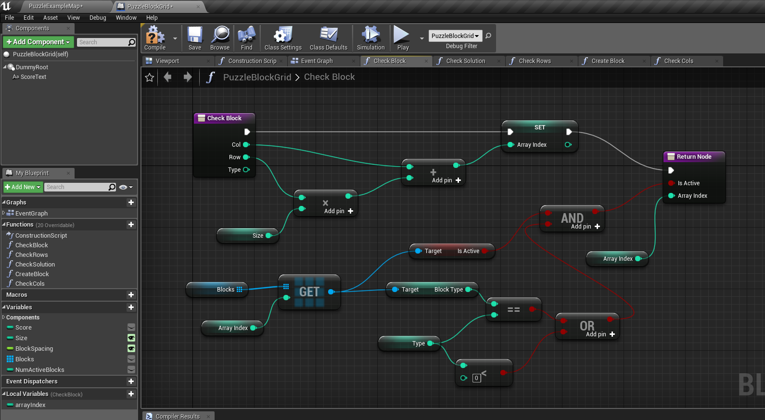
Add function: CheckBlock(Col,Row,Type)
Add local variable Array Index.
Compute arrayIndex which directly shows the index of [Col,Row] pair.
Type parameter is the blocktype of the block. For negative values the type check is ignored. (First time only)
You get access input parameter of a function by using a getter which can be accessed from the blueprints context menu.
CHECKBLOCK(1/5)

Slide 46
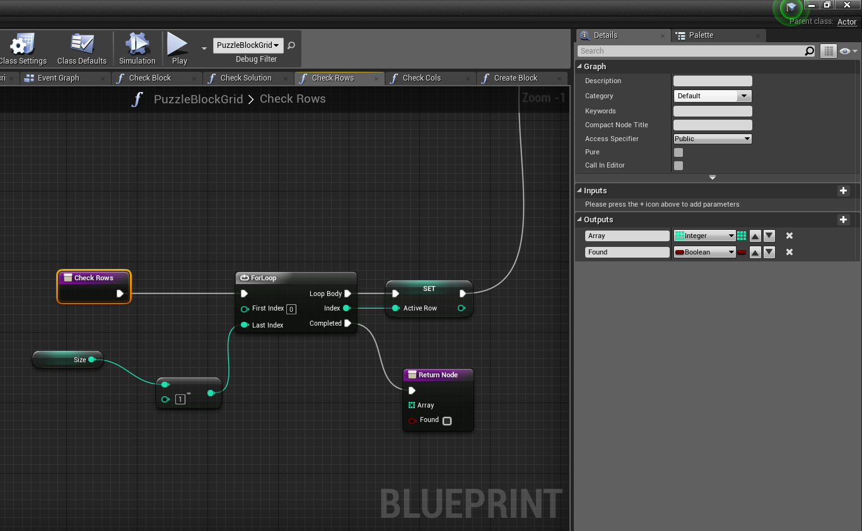
CHECK ROWS (2/5)
We will start checking each row for a solution. So the order will be like:
For Row 0:
Cols (0,1,2)
Cols (1,2,3)
For Row 1:
Cols (0,1,2)
Cols (1,2,3)
… etc
Rows will be increasing from 0 to 3.
(= from 0 to Size-1)
For every row, cols will be check from 0 to 1. (= from 0 to Size-3)
Size = 4!
CheckRows() return an Integer array and a Boolean.
Array: List of array indices containing the blocks to be destroyed.
The integer values are direct indices to Blocks array.
Found: Did we find a solution?

Slide 47
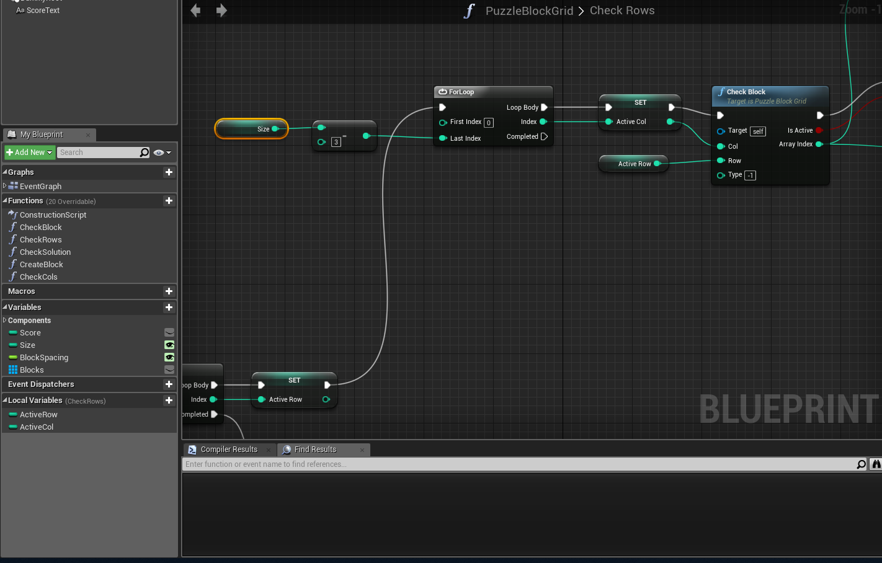
CHECK ROWS (3/5)
Add to Local Variables to CheckRows:
ActiveRow and ActiveCol
Add the 2nd inner loop for interating Coloumns from 0 to Size-3
Add CheckBlock to check the contents of the blocks at the corresponding [Row,Col] pair.
Set ActiveCol

Slide 48
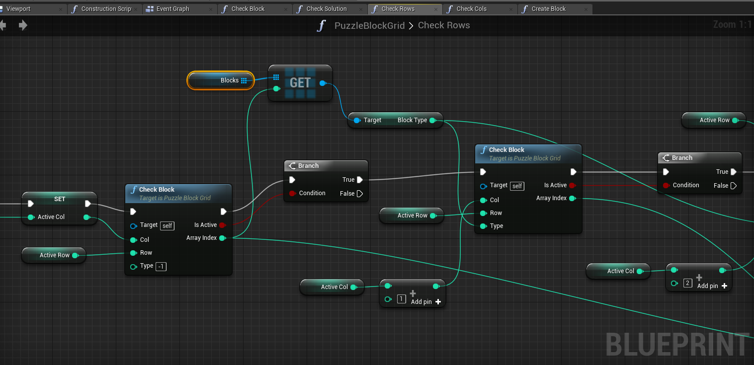
If the first [Row,Col] is not empty then get the blocktype and check for [Row,Col+1] and [Row,Col+2]
Beware! First CheckBlock has an input Type values as -1 to skip the BlockType check in the node.
CHECK ROWS (4/5)

Slide 49
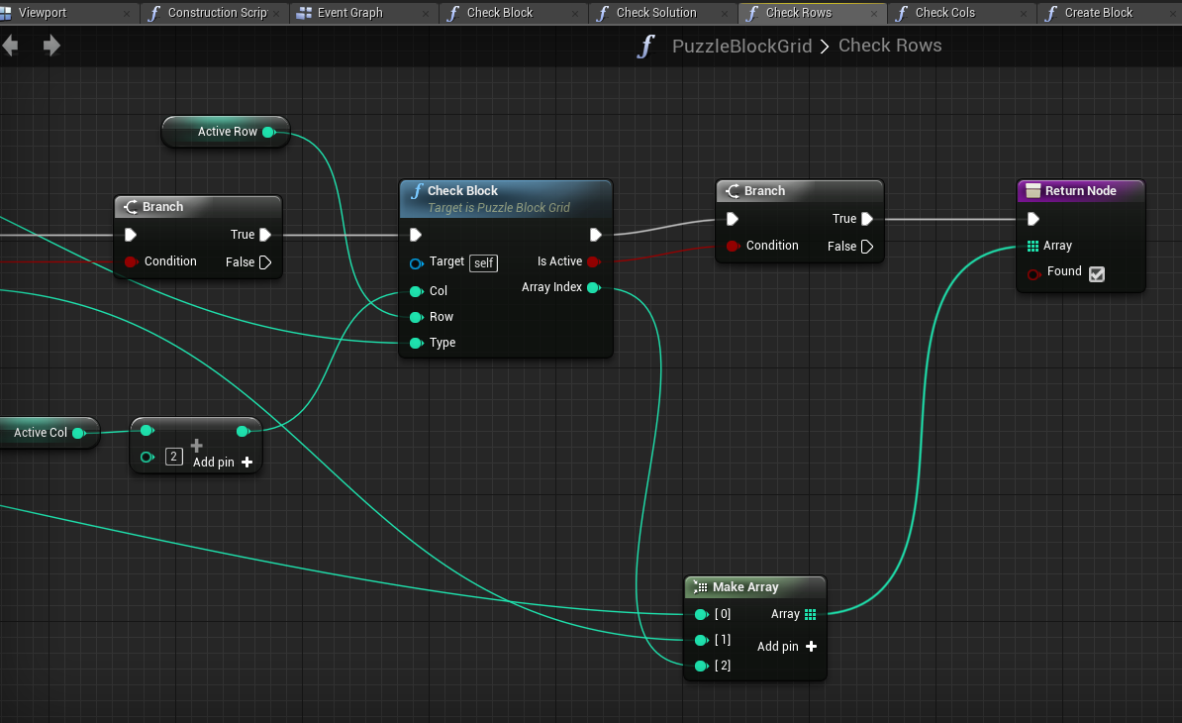
If all success then put all array indices into an array as pass as the output.
New Node: MakeArray which is used to build an array on the fly.
CHECK ROWS (5/5)

Slide 50
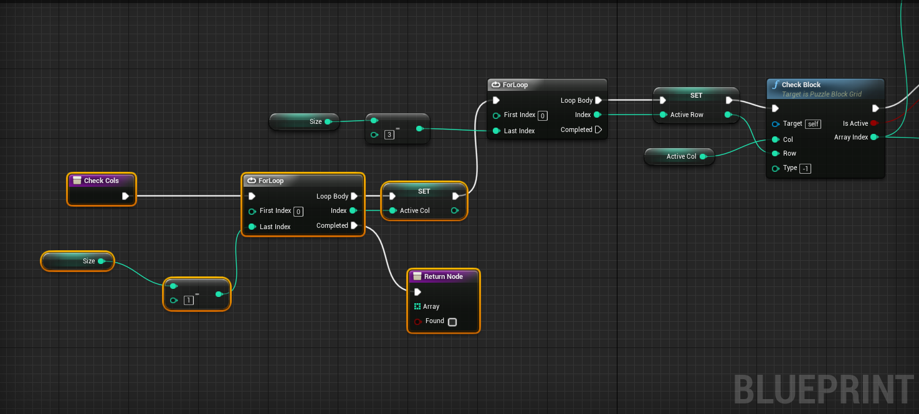
Make a copy of the function CheckRows and rename it to CheckCols.
This function does the same as CheckRows but it swaps the usages of ActiveCol and ActiveRows.
The necessary changes to the rest of the function. (Not included in the following slides.)
CHECK COLS

Slide 51
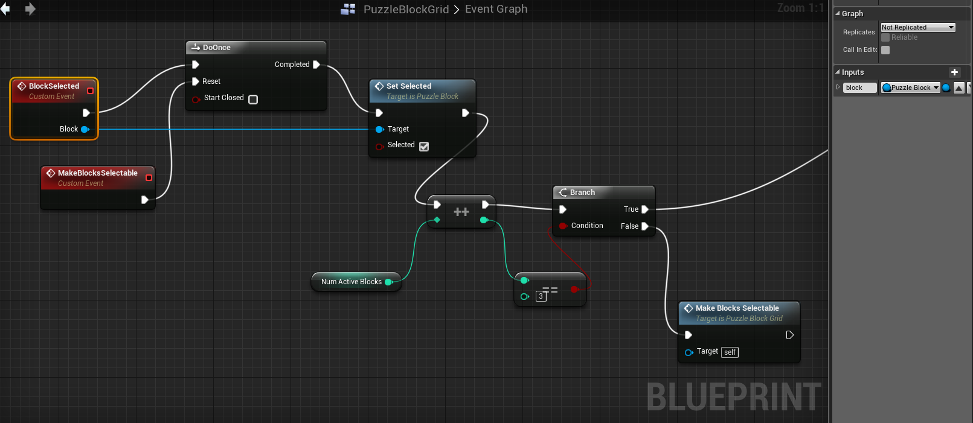
PUZZLEBLOCKGRID BLOCKSELECTED (1/3)
Add Custom Event: BlockSelected
Add an input variable of type PuzzleBlock object referance named Block.
Once BlockSelected called, it check for the solution if NumActiveBlocks have reached 3.
If not Selection of blocks will be enabled again. (Because DoOnce node would blok selecting again it if a group block breaking happens.)
Note: ++ is IncreamentInt node.

Slide 52
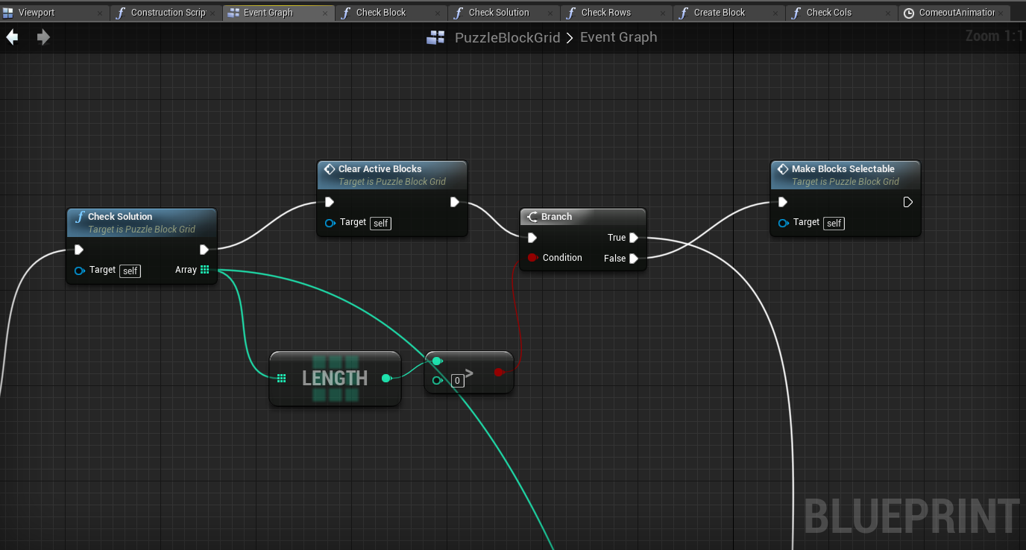
PUZZLEBLOCKGRID BLOCKSELECTED (2/3)
When selected blocks reach 3, then we check for the solution.
If there is a solution then out Array size will be greater than 0 (Size will be always 3 is our case.)
If the array is zero than there is no solution, thus we can re-enable selection of blocks.(Make Blocks Selectable retriggers Reset of DoOnce node.)

Slide 53

PUZZLEBLOCKGRID BLOCKSELECTED (3/3)
Here we create new blocks, break selected ones (Break like destructible mesh)
And start a popping-up animation.
When the animation ends, blocks became selectable again.
Consider using DestroyActor instead of BreakBlock function in the example below.

Slide 54

PUZZLEBLOCKGRID BLOCKSELECTED (POPPING-OUT ANIMATION)
1 second animation which affects the global scale of the newly added blocks.

Slide 55

PUZZLEBLOCK
Change the OnClicked event of the block as follows:
This change will make the grid look for a solution whenever a block was activated.

